Slide 1
Is living in a big city like Toronto affordable for a young person?
Capstone project- The Battle of Neighbourhood

Slide 2

Toronto is a multicultural city that continues to attract a big number of expats from different countries in the world.
Toronto has a lot of opportunities for a young person to live; study and work, but to decide to move to Toronto or start to live alone there, needs some consideration.

Slide 3
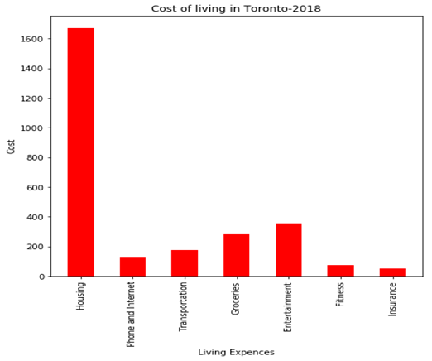
Cost Of Living in Toronto
Basic Expenses of a modern life:
1-Housing: $1,672.13
2-Phone and Internet: $127.50
3-Transportation: $176.25
4-Groceries: $283.60
5-Entertainment: $354
6-Fitness: $75
7-Insurance: $52
Grand Total: $2,740.48/month
Or $32,885 annually

Slide 4
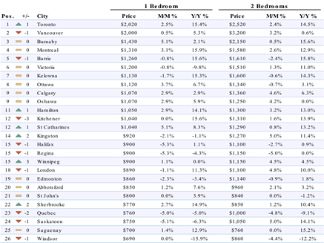
Cost of Rent
According to rental website,
Toronto is the most expensive city
in Canada for rent. Here is a table
of comparison for renting prices of
one-bedroom and two-Bedroom
apartment in different cities in
Canada.

Slide 5
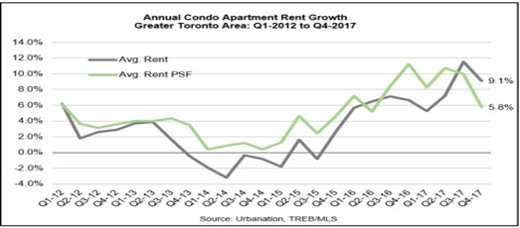
Rent growth
According to The
“Urban Nation” the
condo rental market
rising by as much as
9.1% at the end of
2017 in downtown
Toronto. The report
listed the average cost
of a condo rental at
$2,166.

Slide 6
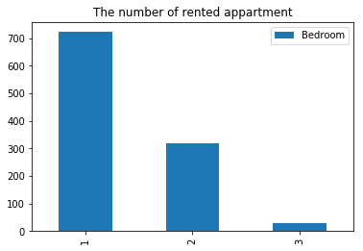
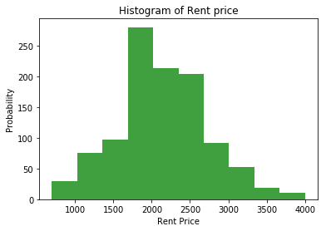
Frequency of apartment based on number of bedrooms
Frequency of apartment with rent price around $2000.0

Slide 7
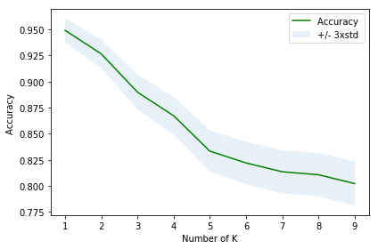
Classification model
K-Nearest Neighbors
Best K =5
Accuracy score = 0.833

Slide 8
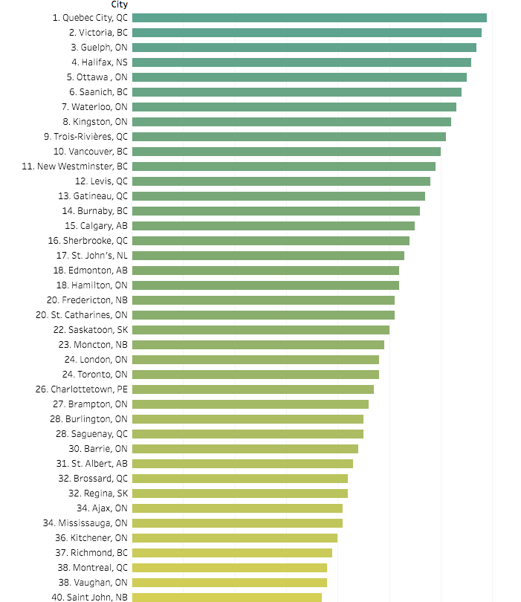
There are also other cities
to think of.
According to “Daily Hive”
Here is a list of the hottest
cities for millennial in
2018:

Slide 9
Foursquare API
Toronto –ON
Venue’s Categories
Victoria –BC
Venue’s Categories
0 | Neighborhood
1 | Art Museum
2 | Ramen Restaurant
3 | Café
4 | Tea Room
5 | Sushi Restaurant
6 | Poke Place
7 | Japanese Restaurant
8 | Arts & Crafts Store
9 | Plaza
10 | University
11 | Bubble Tea Shop
12 | Chinese Restaurant
13 | Concert Hall
14 | Coffee Shop
15 | Tapas Restaurant
16 | Middle Eastern Restaurant
17 | Opera House
18 | Smoke Shop
19 | Breakfast Spot
20 | Art Gallery
0 | Vegetarian / Vegan Restaurant
1 | French Restaurant
2 | Sporting Goods Shop
3 | Tapas Restaurant
4 | Coffee Shop
5 | Tea Room
6 | Sandwich Place
7 | Lounge
8 | Gaming Cafe
9 | Breakfast Spot
10 | Café
11 | Bakery
12 | Sushi Restaurant
13 | Comic Shop
14 | Indian Restaurant
15 | Restaurant
16 | Gym
17 | Farmers Market
18 | Modern European Restaurant
19 | Italian Restaurant
20 | Hotel

Slide 10
Conclusion & Recommendation
Both cities have a lot of Venues in common, we can choose a city based on our interest of job or activities.
Some ways of reduce the cost down by doing the following:
• Renting with friends or a co-worker- Consider finding a roommate to slash your rent by 50% or more.
• Avoid the flashy areas– In most large cities and find a place that’s a few blocks away.

